Slide 1
Spring 2017 data analysis

Slide 2
Research Question
What are the joint effects of performance and solution transparency on the innovation outcome?

Slide 3
Hypotheses
Full transparency has the highest innovation performance compared to all 3 of the other treatment groups
Full transparency has the highest effort compared to all 3 of the other treatment groups
Full transparency has a higher total score of the apps being clicked across all phases compared to solution transparency
Full transparency has a higher number of clicks assigned to an app compared to solution transparency
Full transparency has a higher number of clicks done by a person compared to solution transparency

Slide 4
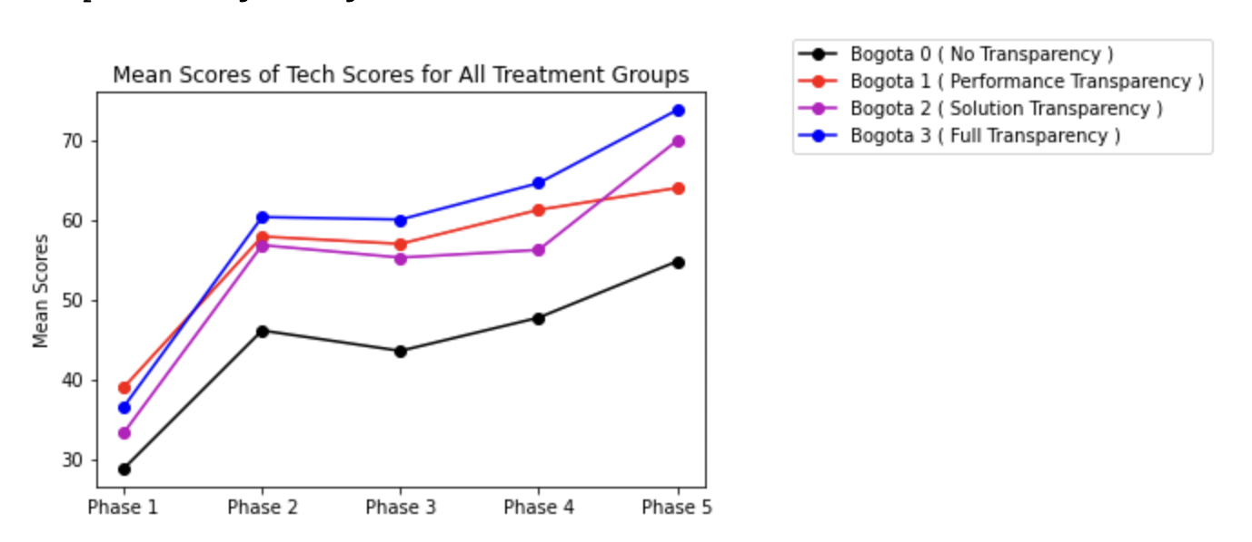
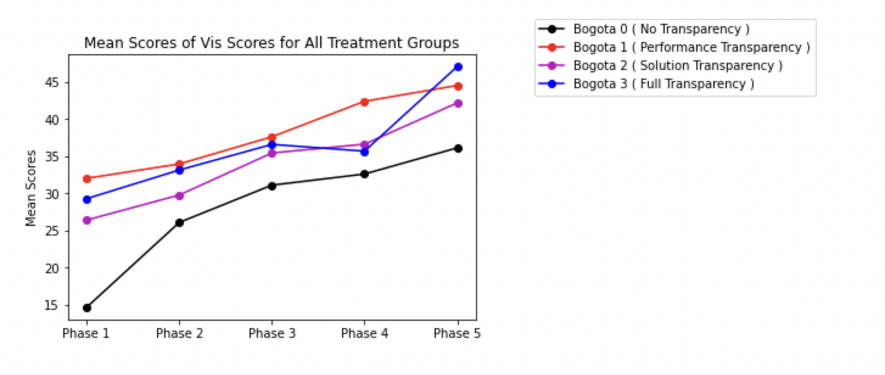
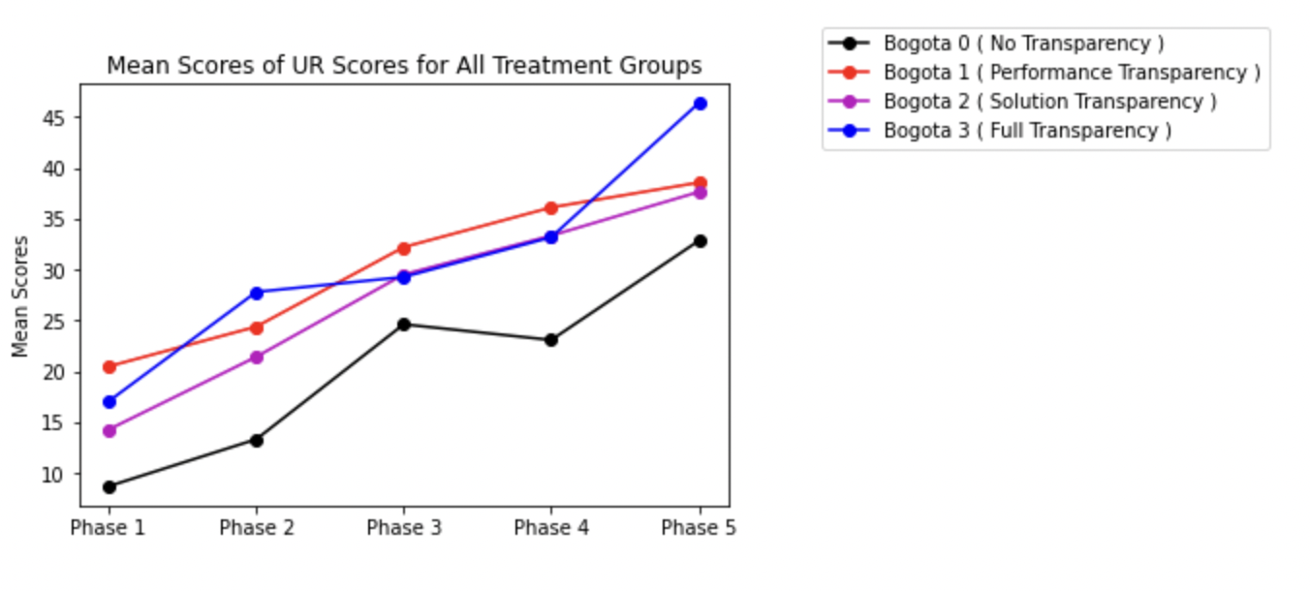
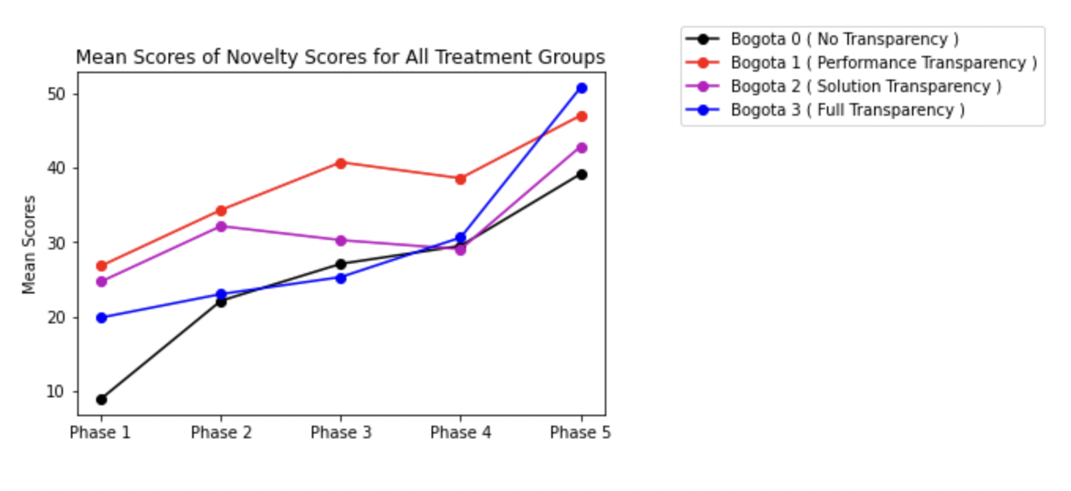
Line Plot of scores in 4 dimensions
Ref Link to Notebook - https://github.com/ironhacks/analysis-2017/blob/main/spring-2017/script/analysis/BoxPlots-LineCharts-BarCharts(Scores%2CLOC%2CD3%2CSurvey).ipynb

Slide 5
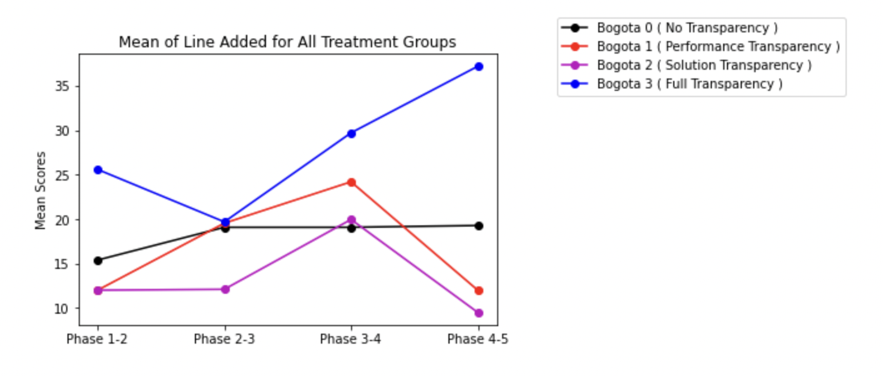
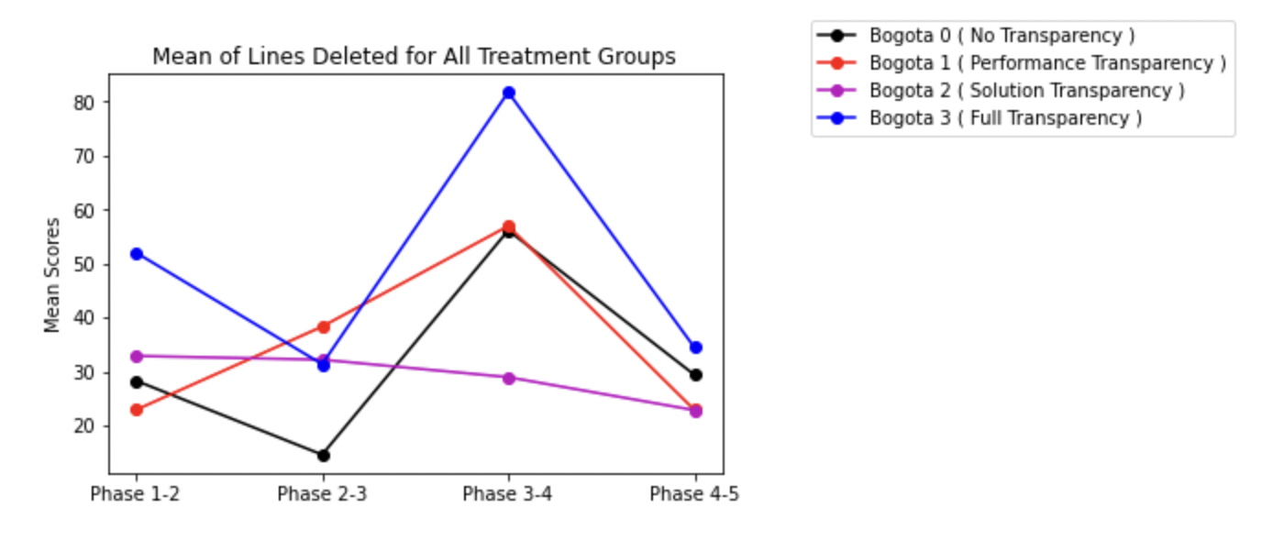
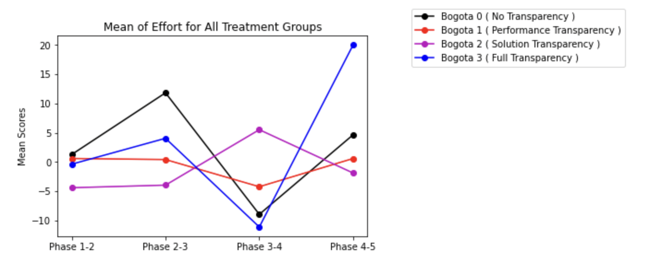
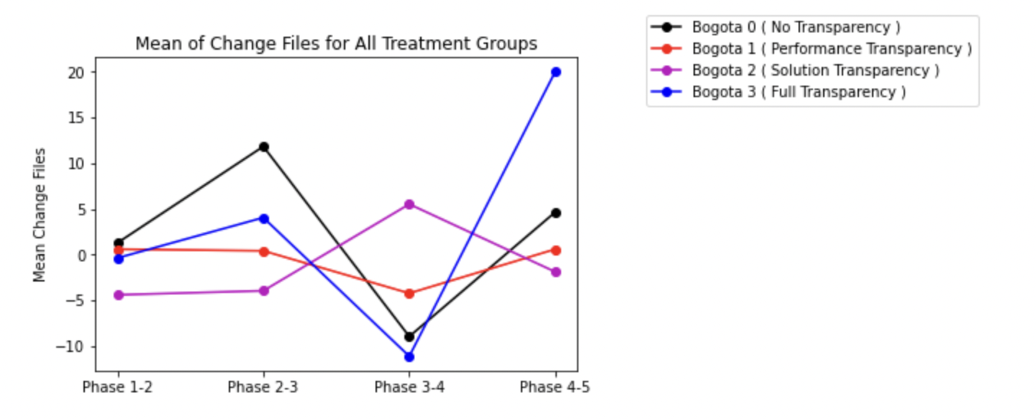
Lines added/deleted/effort/files change
Ref Link to Notebook - https://github.com/ironhacks/analysis-2017/blob/main/spring-2017/script/analysis/BoxPlots-LineCharts-BarCharts(Scores%2CLOC%2CD3%2CSurvey).ipynb

Slide 6
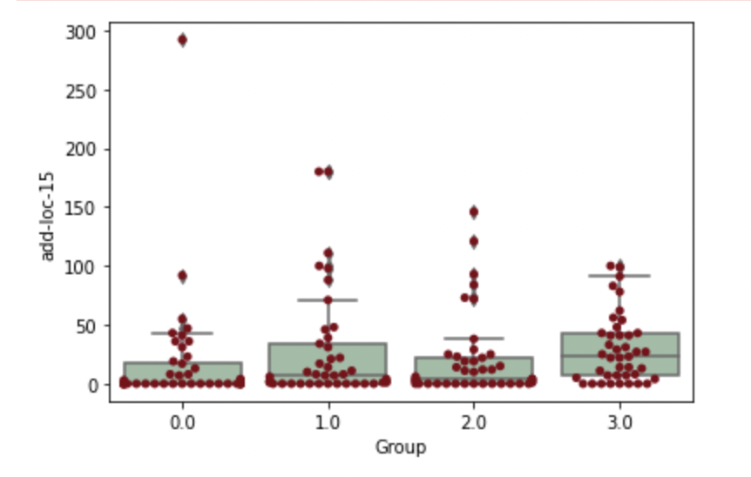
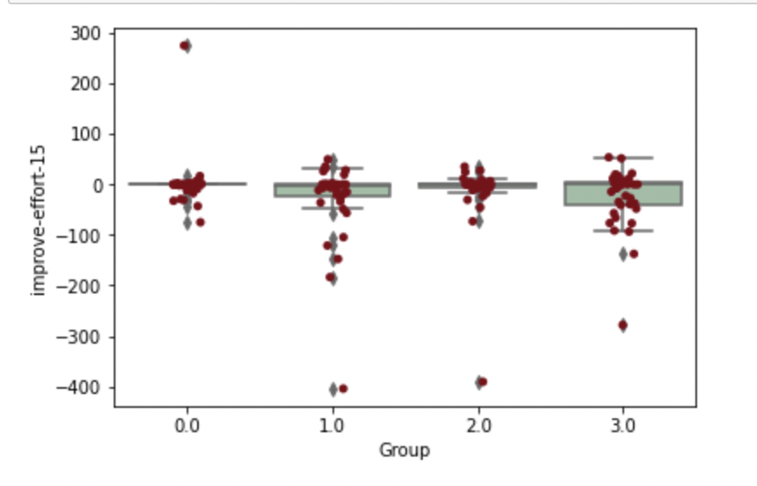
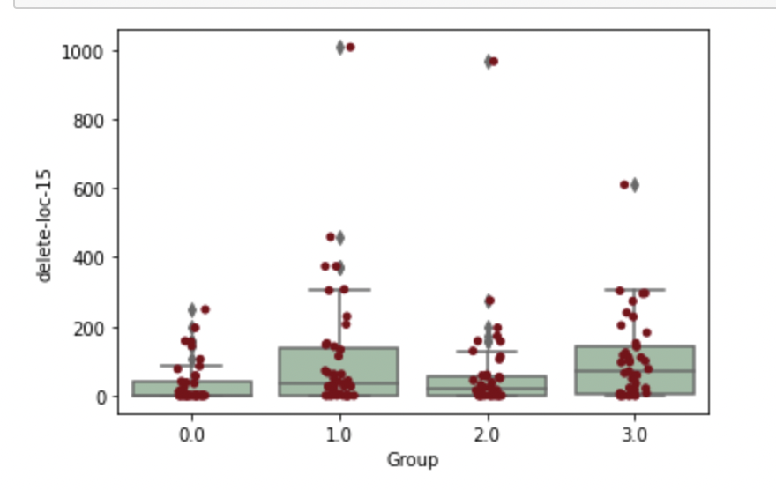
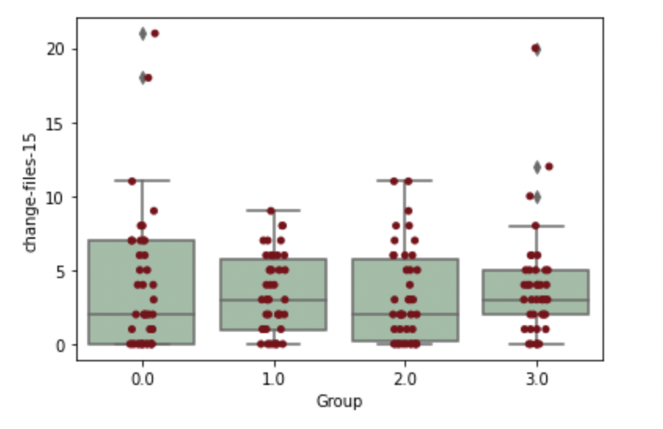
Median Lines added/deleted/effort/files change

Slide 7
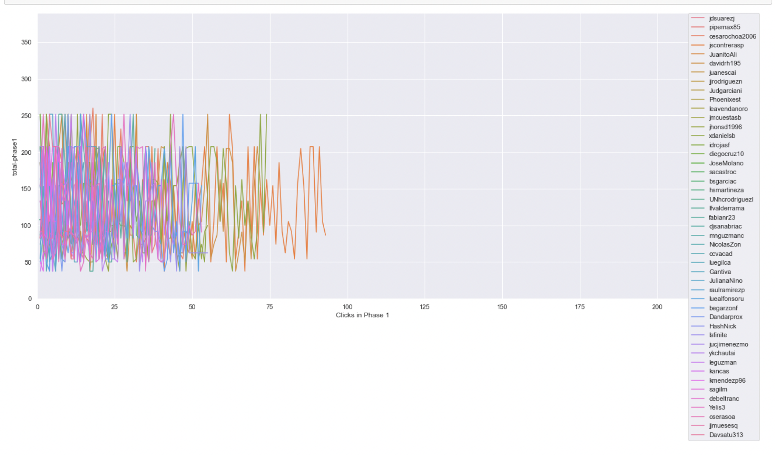
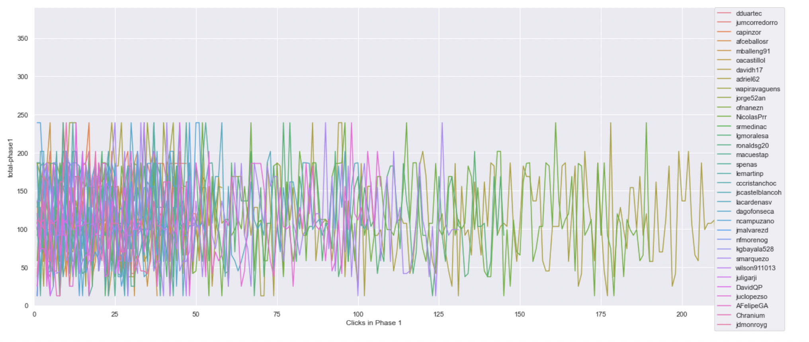
Timeline plot of scores of projects clicked on in phase 1 ( same scale )
Ref Link - https://github.com/ironhacks/analysis-2017/blob/main/spring-2017/script/analysis/Clicks-Analysis(Graphs%2CDescriptive-Analysis).ipynb
Bogota 2 ( Solution Transparency Only ) | Bogota 3 ( Full Transparency )

Slide 8
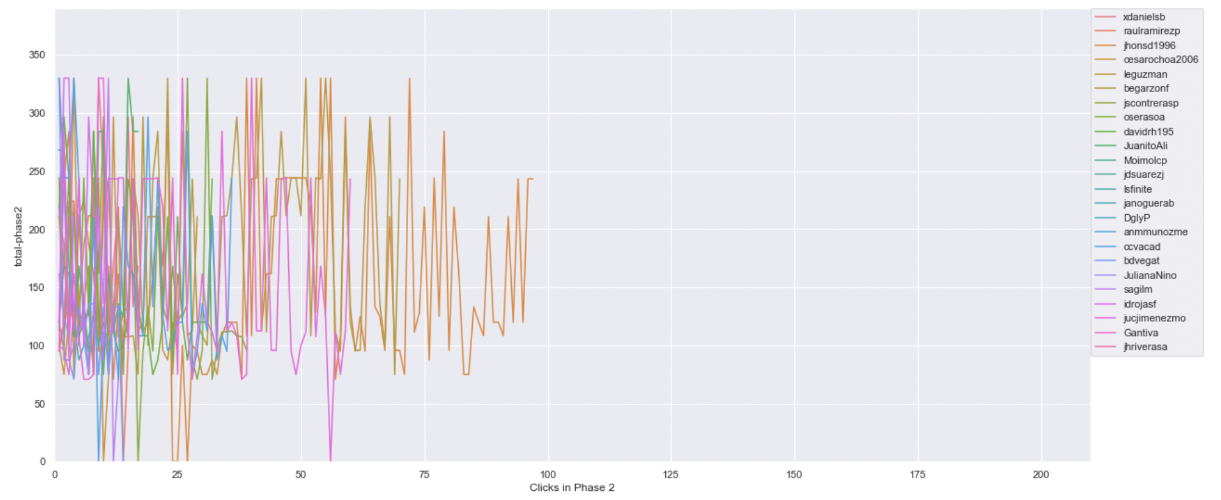
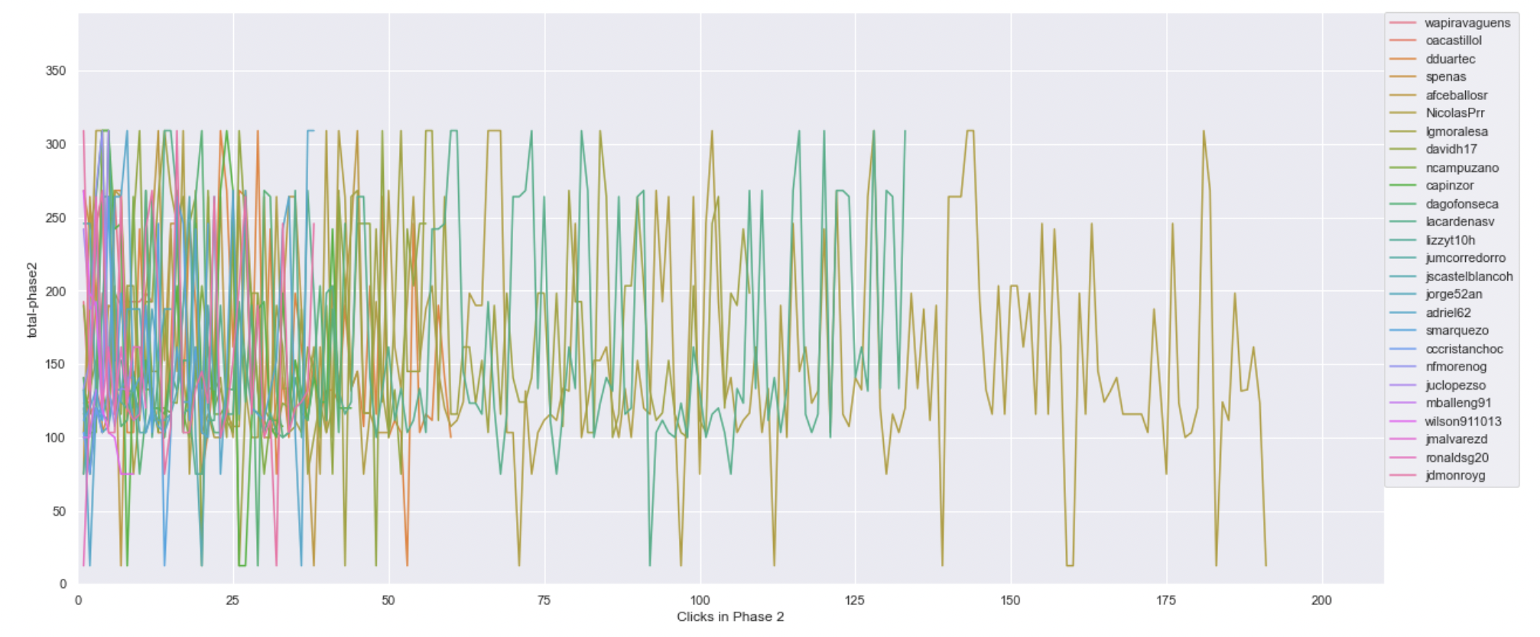
Timeline plot of scores of projects clicked on in phase 2 ( same scale )
Ref Link - https://github.com/ironhacks/analysis-2017/blob/main/spring-2017/script/analysis/Clicks-Analysis(Graphs%2CDescriptive-Analysis).ipynb
Bogota 2 ( Solution Transparency Only ) | Bogota 3 ( Full Transparency )

Slide 9
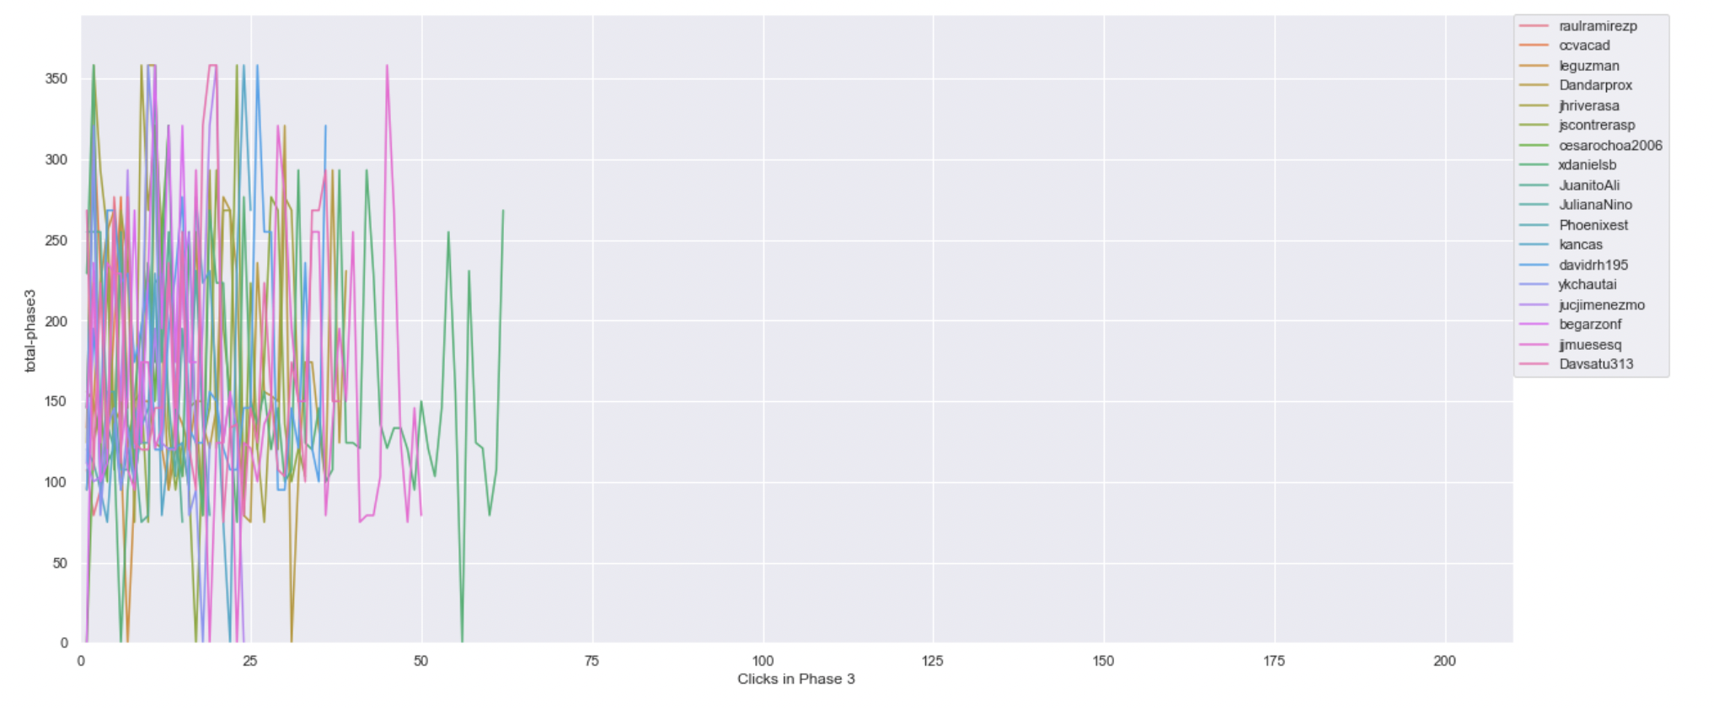
Timeline plot of scores of projects clicked on in phase 3 ( same scale )
Ref Link - https://github.com/ironhacks/analysis-2017/blob/main/spring-2017/script/analysis/Clicks-Analysis(Graphs%2CDescriptive-Analysis).ipynb
Bogota 2 ( Solution Transparency Only ) | Bogota 3 ( Full Transparency )

Slide 10
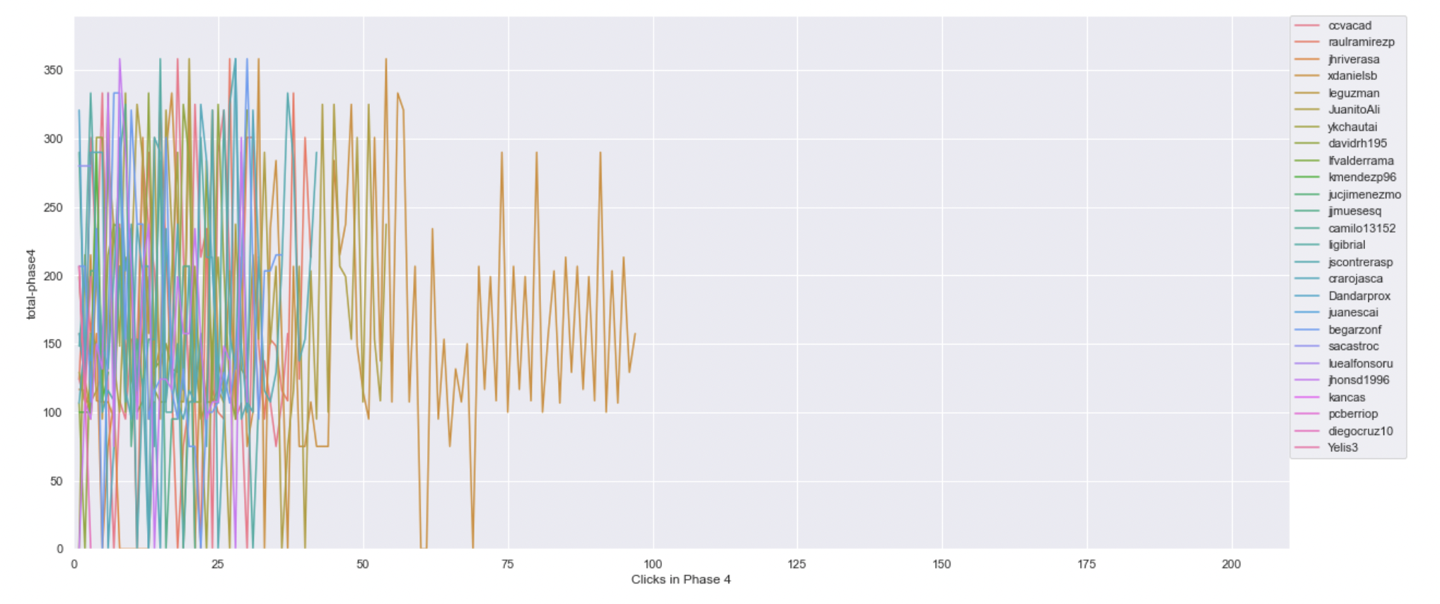
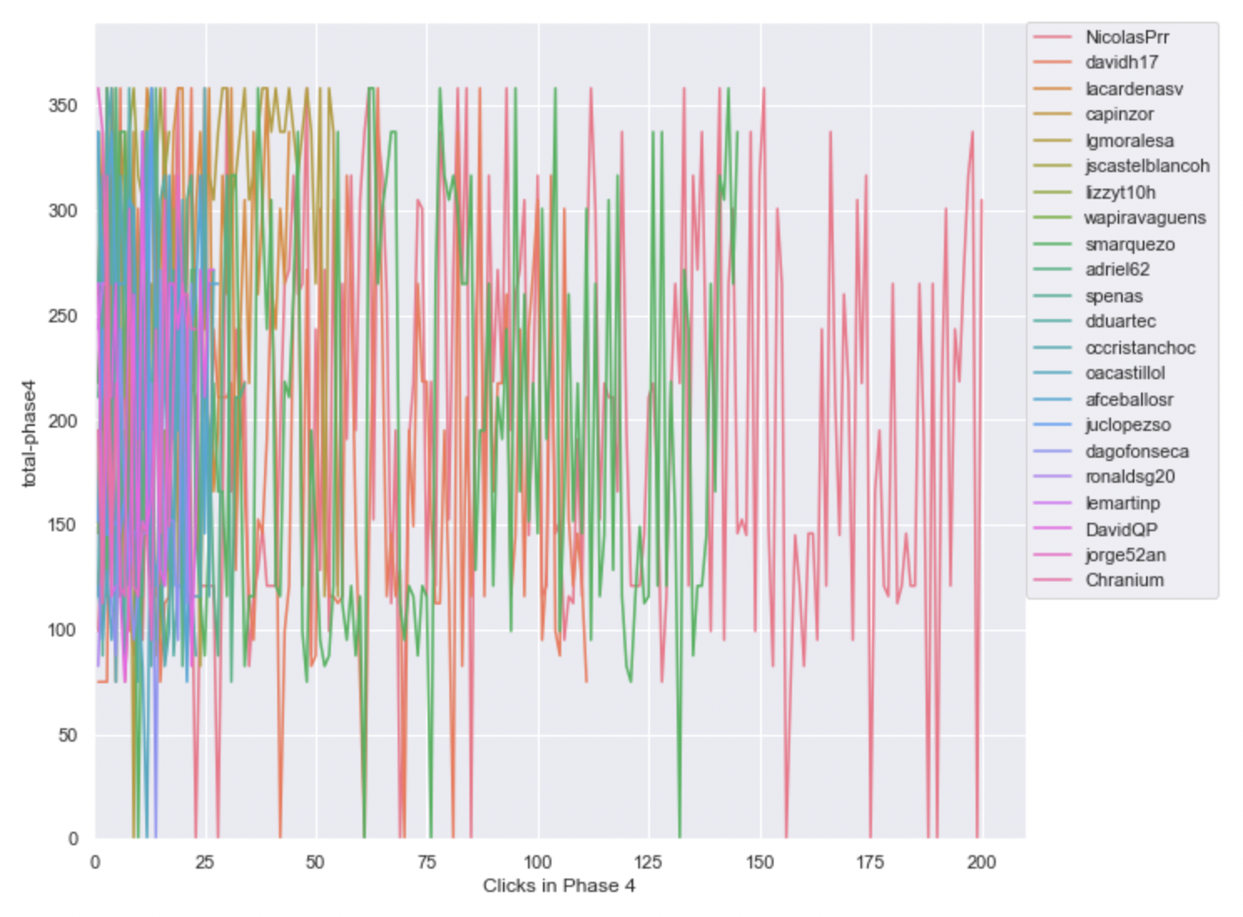
Timeline plot of scores of projects clicked on in phase 4 ( same scale )
Ref Link - https://github.com/ironhacks/analysis-2017/blob/main/spring-2017/script/analysis/Clicks-Analysis(Graphs%2CDescriptive-Analysis).ipynb
Bogota 2 ( Solution Transparency Only ) | Bogota 3 ( Full Transparency )

Slide 11
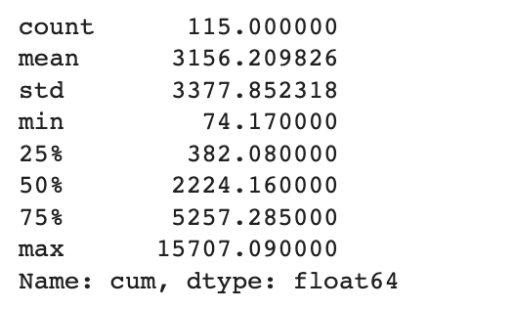
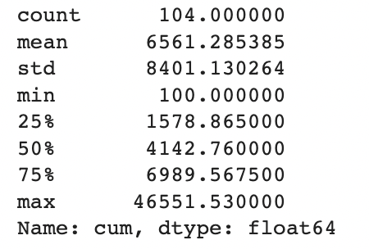
Total Score of the Apps Being Clicked Across All Phases ( Descriptive Analysis )
Ref Link - https://github.com/ironhacks/analysis-2017/blob/main/spring-2017/script/analysis/Clicks-Analysis(Graphs%2CDescriptive-Analysis).ipynb
Bogota 2 ( Solution Transparency ) | Bogota 3 ( Full Transparency )

Slide 12
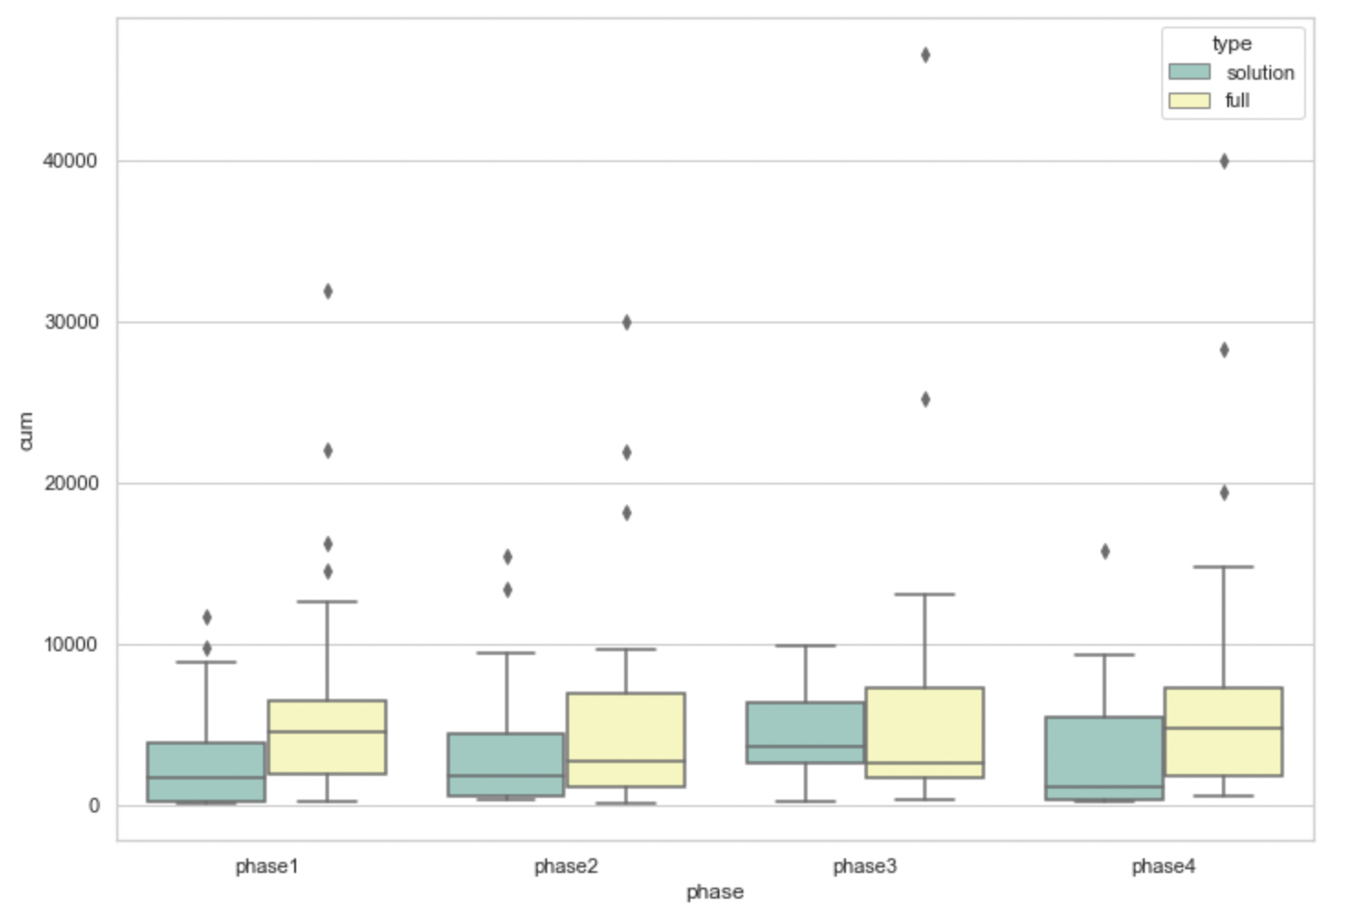
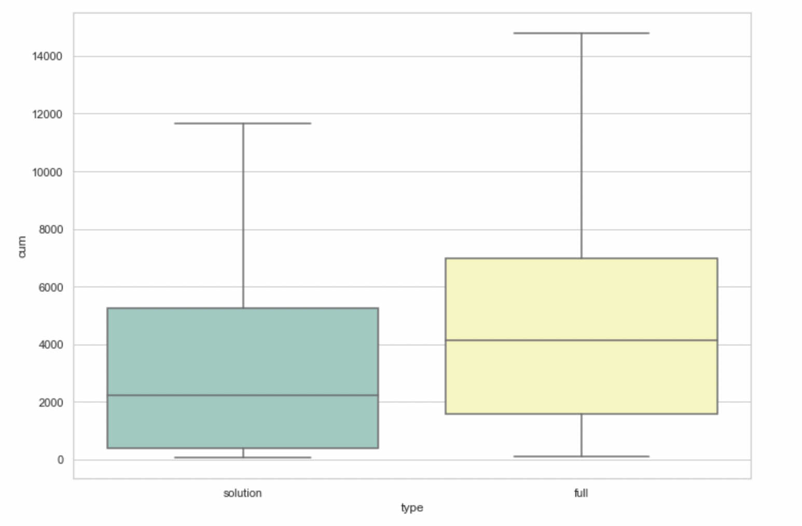
Total Score of the Apps Being Clicked Across All Phases ( box plots )
pvalue=0.00017575311061889564
( Independent T-test )

Slide 13
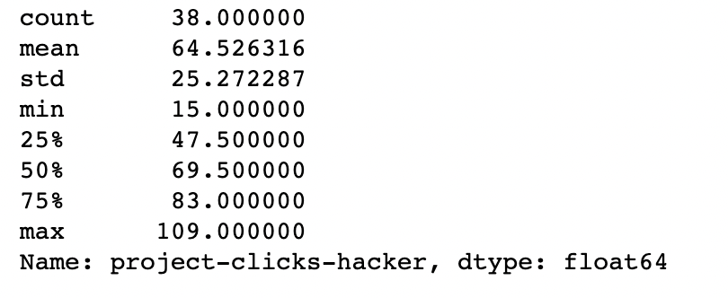
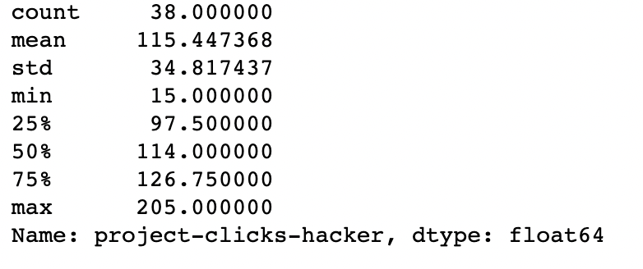
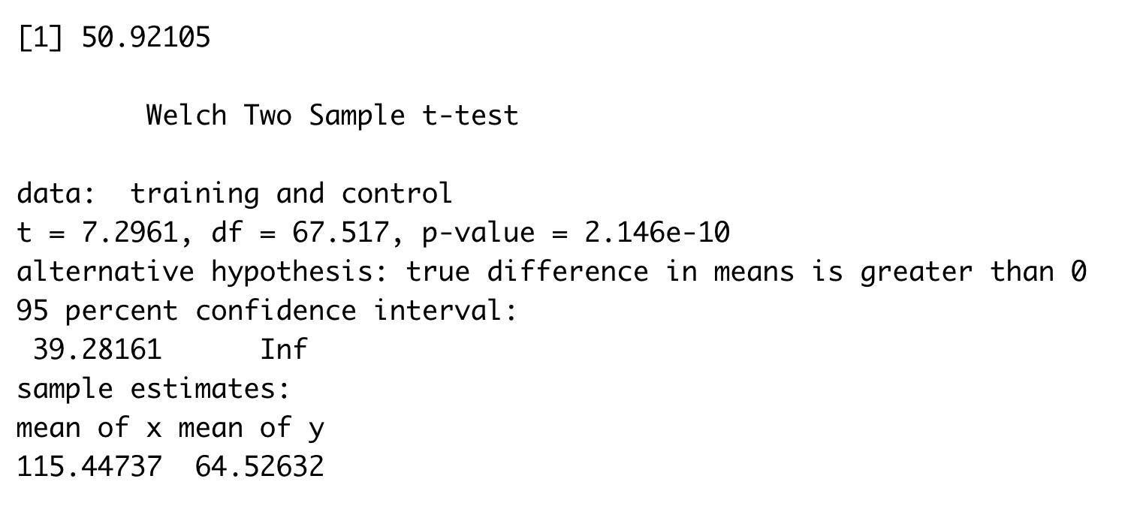
The number of clicks assigned to an app
Bogota 2 ( Solution Transparency ) | Bogota 3 ( Full Transparency )

Slide 14
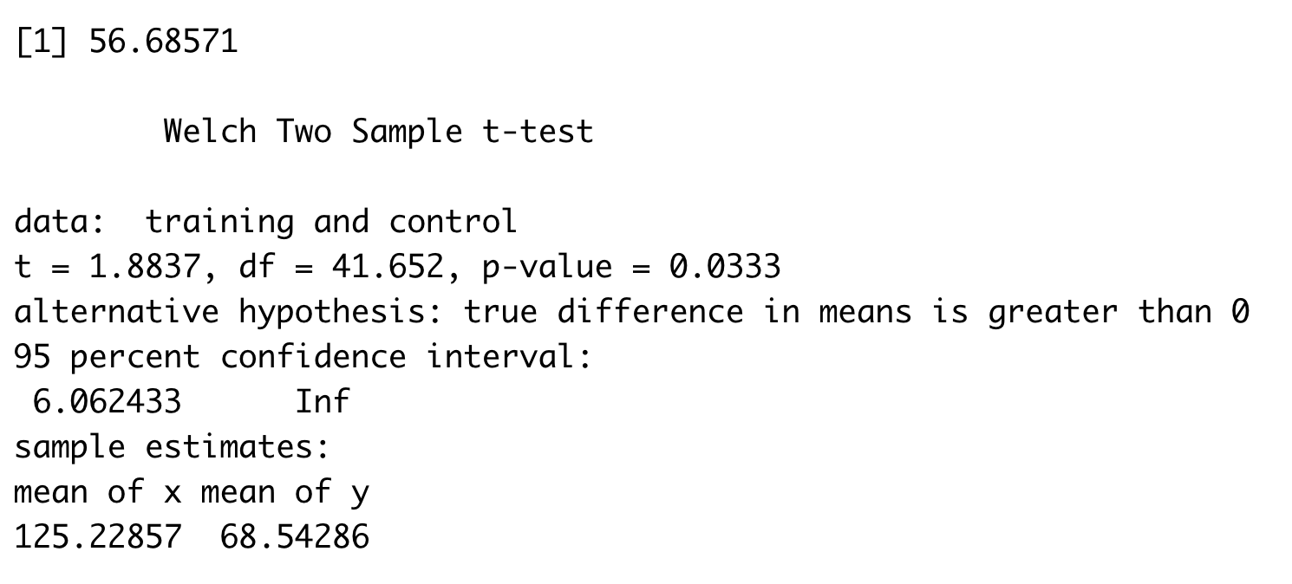
The number of clicks done by a person
Bogota 2 ( Solution Transparency ) | Bogota 3 ( Full Transparency )
Stats for Solution Transparency Min. : 1.00 1st Qu.: 32.00 Median : 55.00 Mean : 68.54 3rd Qu.: 88.00 Max. :250.00 NA's :7 | Stats for Full Transparency Min. : 1.0 1st Qu.: 43.0 Median : 60.0 Mean :125.2 3rd Qu.:128.5 Max. :821.0 NA's :6

Slide 15
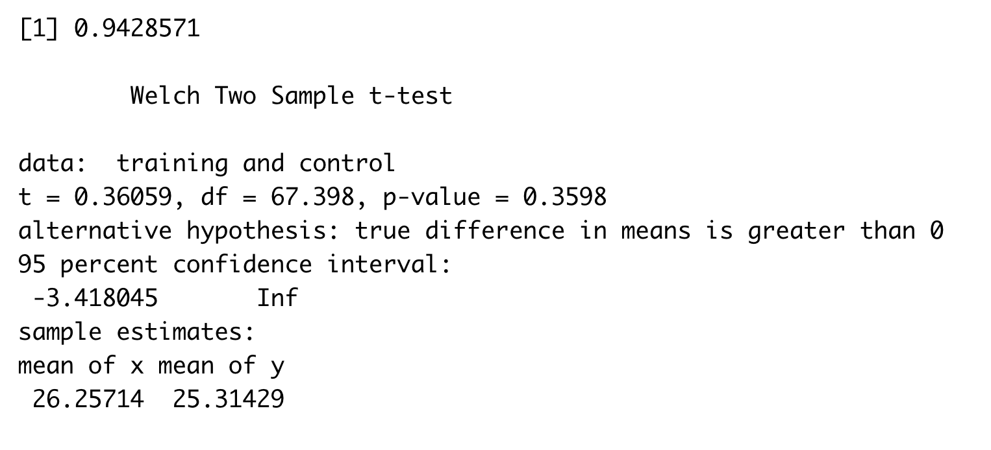
The number of unique apps explored
Bogota 2 ( Solution Transparency ) | Bogota 3 ( Full Transparency )
Stats for Solution Transparency count 35.000000 mean 25.314286 std 10.408626 min 1.000000 25% 20.500000 50% 27.000000 75% 34.500000 max 37.000000 | Stats for Full Transparency count 35.000000 mean 26.257143 std 11.443834 min 1.000000 25% 21.500000 50% 29.000000 75% 36.500000 max 38.000000

Slide 16
Cross stage similarity metrics on an individual level (Variable Name: individual_exploration (IND_EXP))

Slide 17
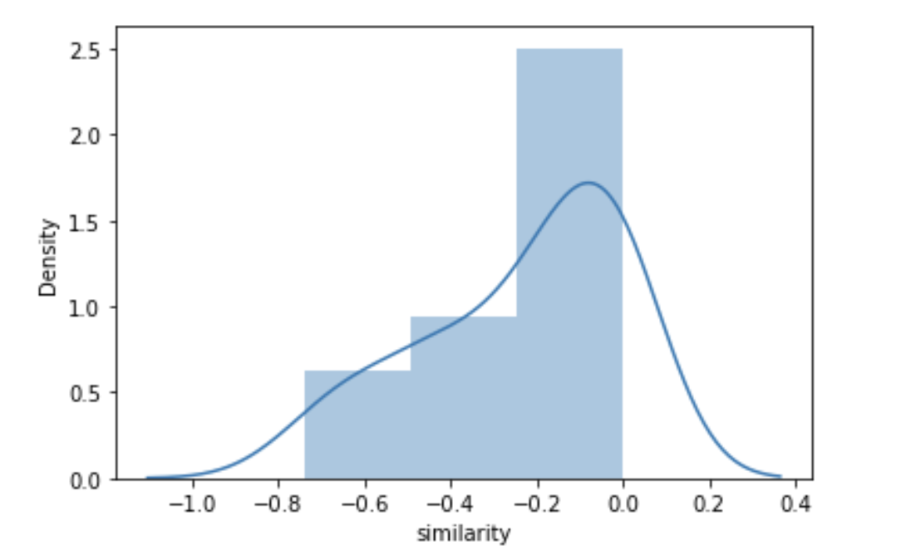
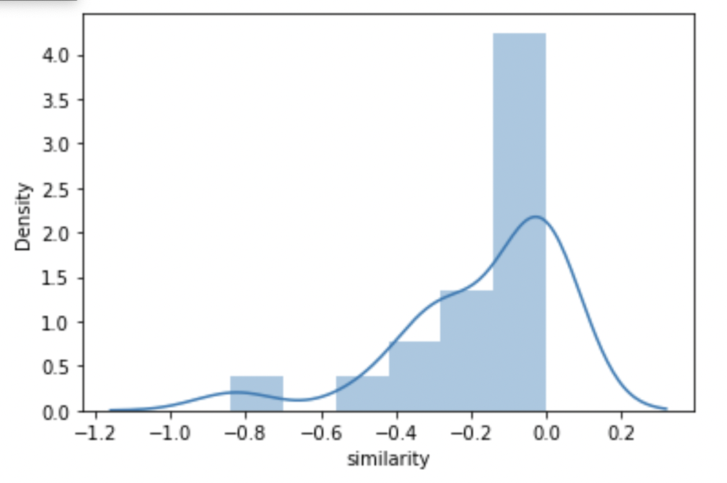
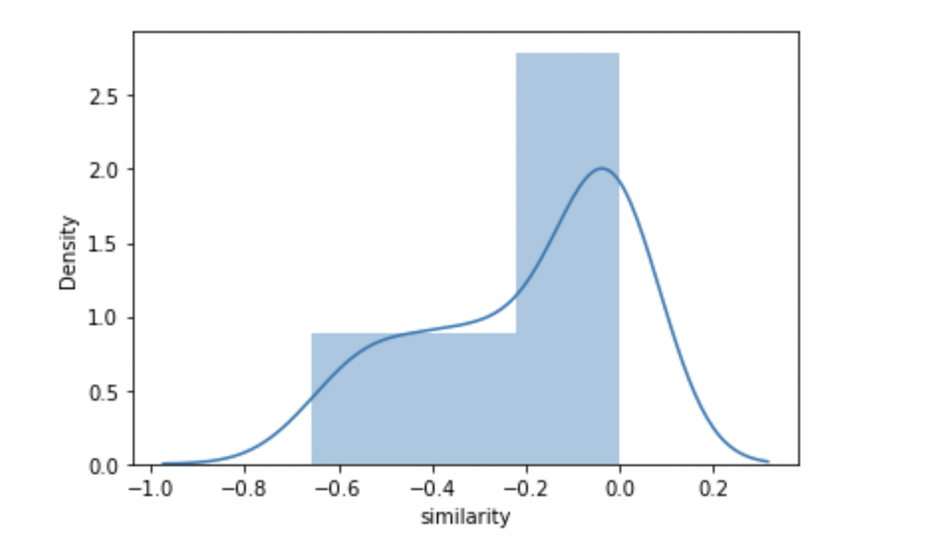
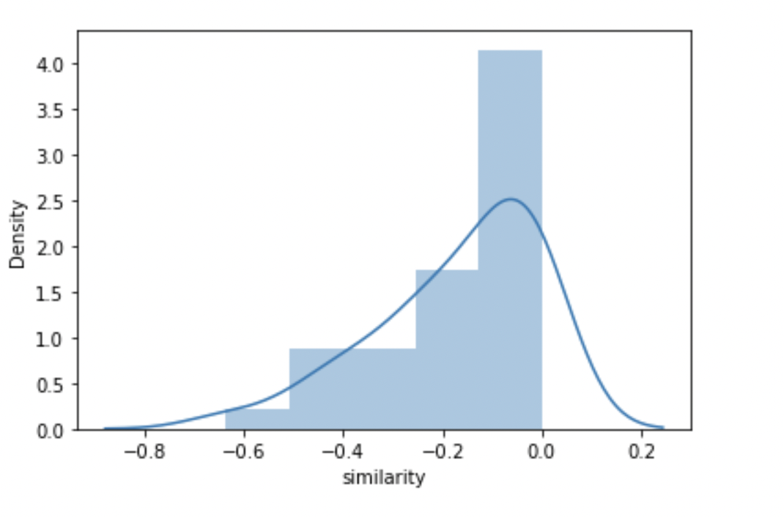
Phase 1-2 After Natural Log Transformation
Bogota 0 | Bogota 1
Bogota 2 | Bogota 3

Slide 18
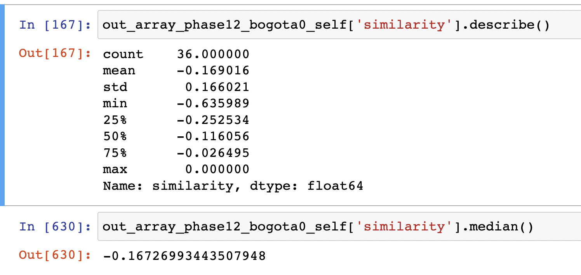
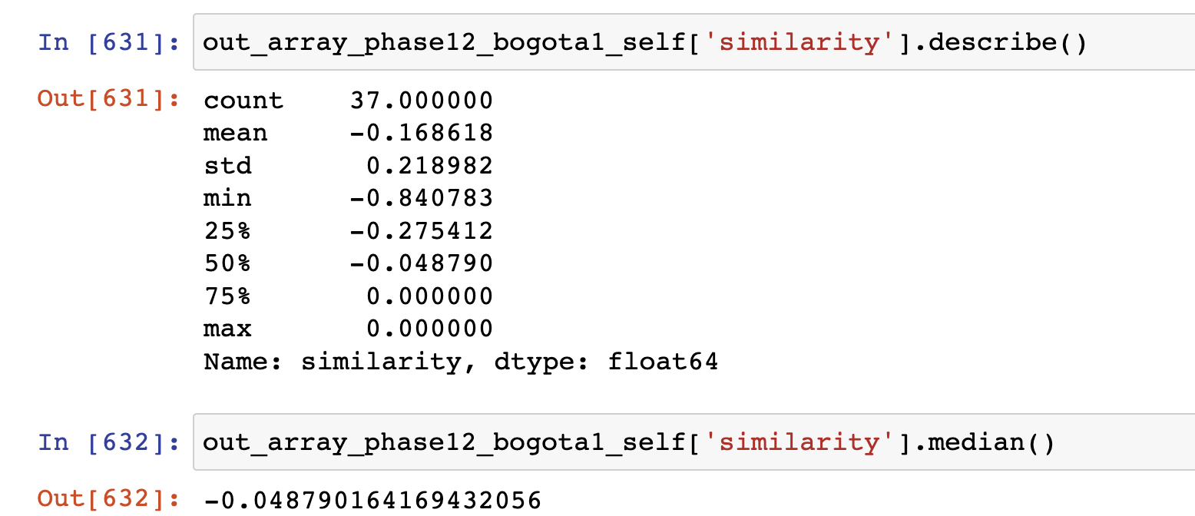
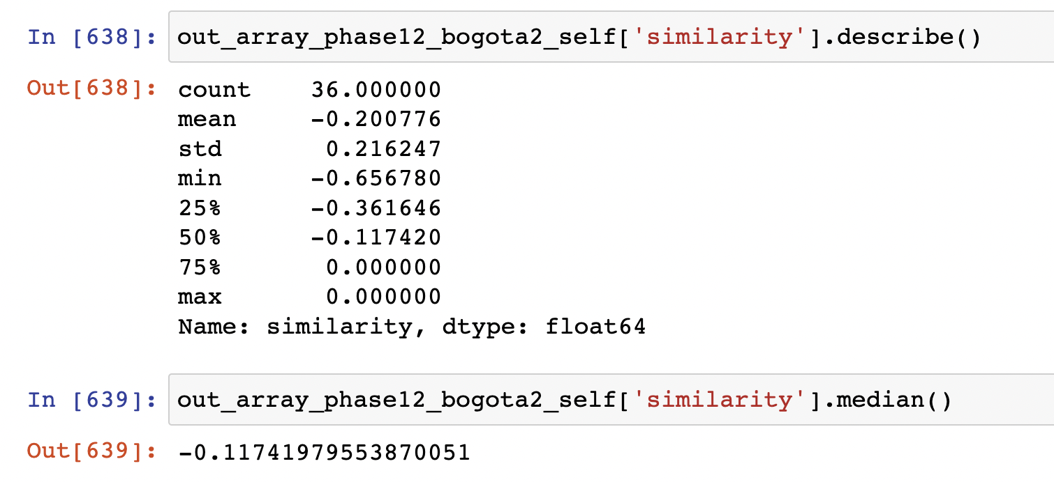
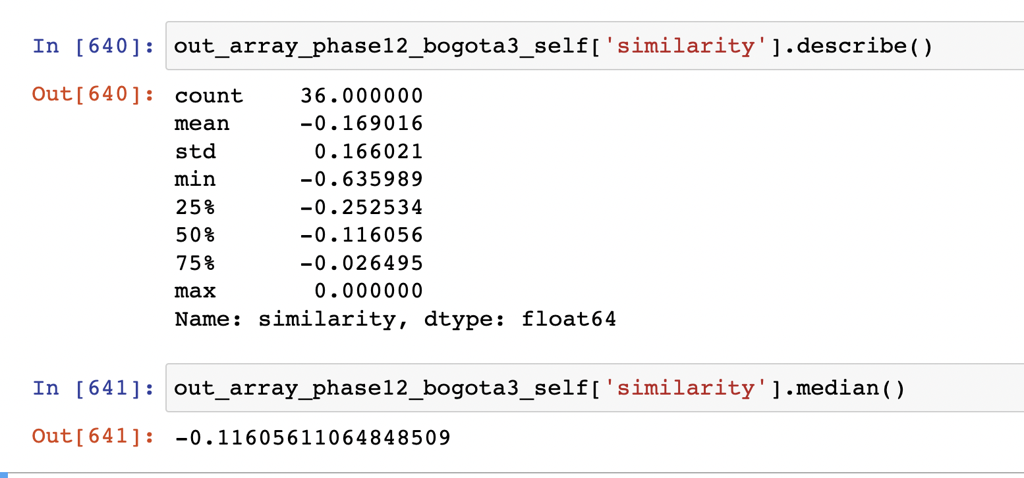
Phase 1-2 After Natural Log Transformation
Bogota 0 | Bogota 1
Bogota 2 | Bogota 3

Slide 19
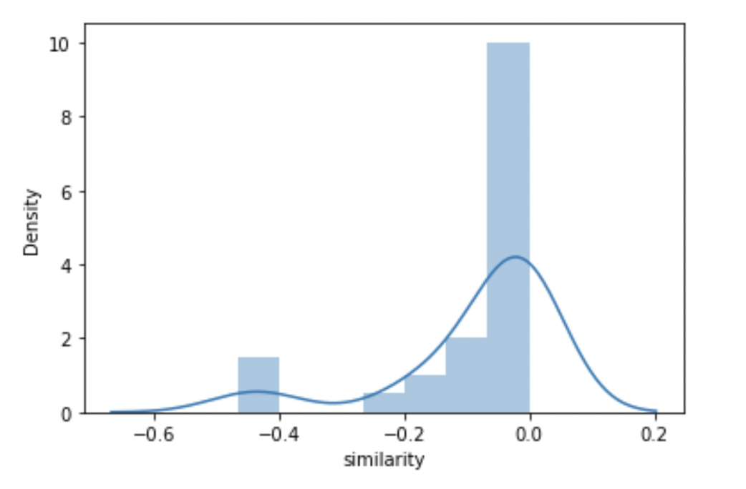
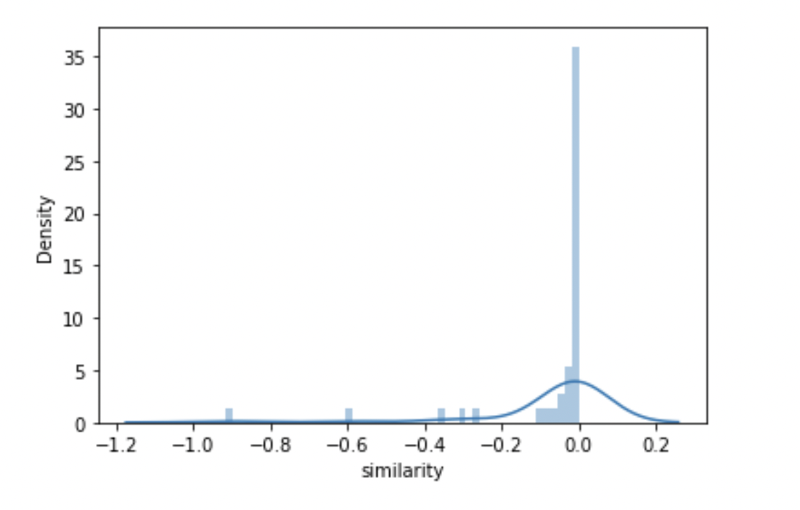
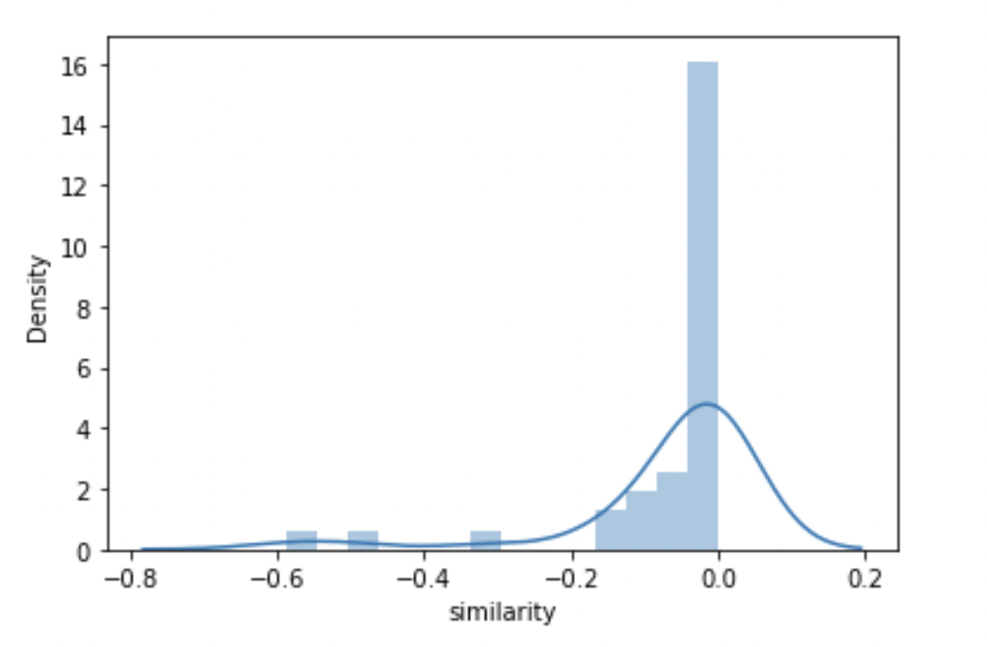
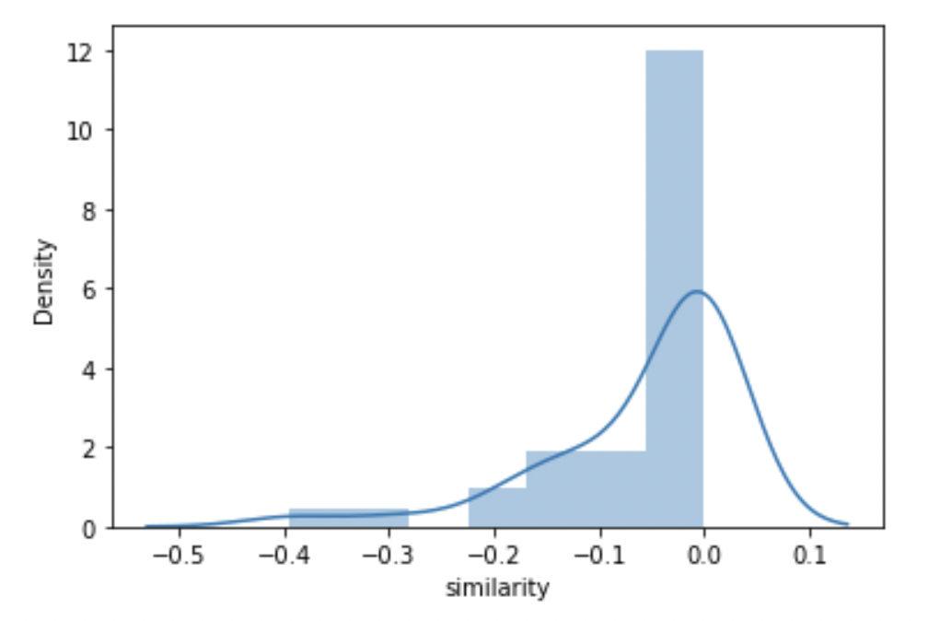
Phase 2-3 After Natural Log Transformation
Bogota 0 | Bogota 1
Bogota 2 | Bogota 3

Slide 20
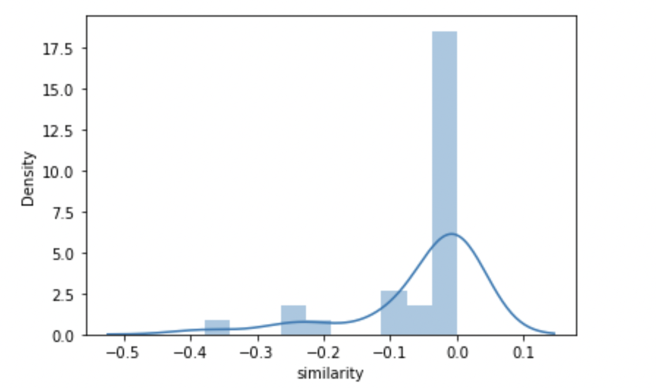
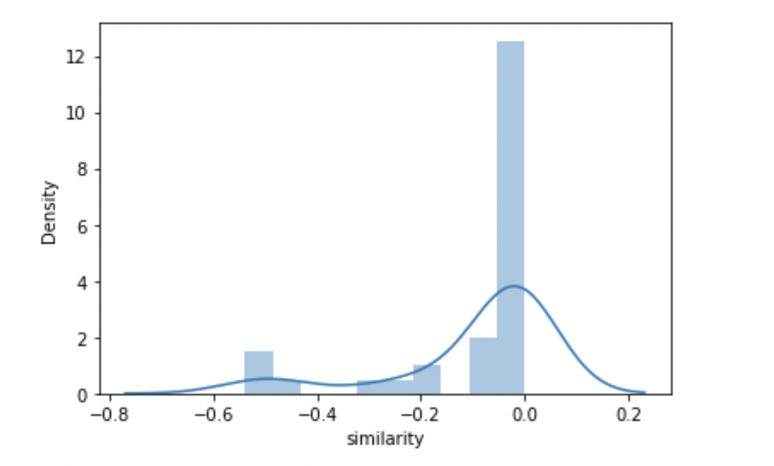
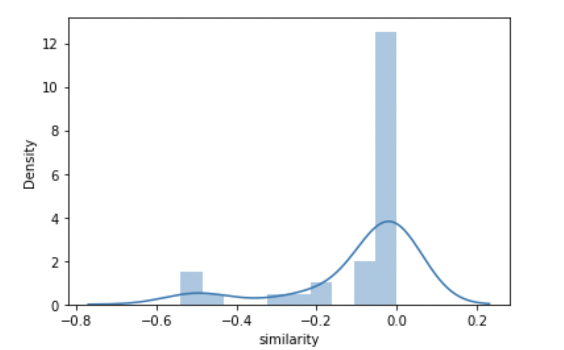
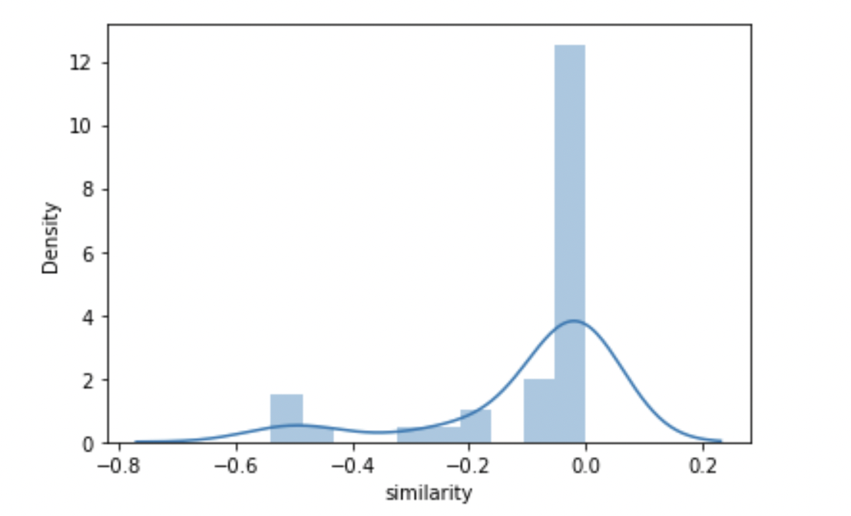
Phase 3-4 After Natural Log Transformation
Bogota 0 | Bogota 1
Bogota 2 | Bogota 3

Slide 21
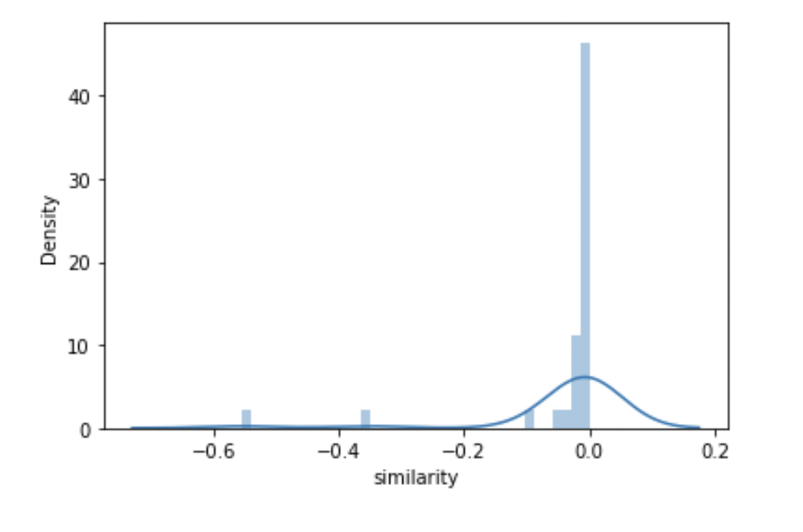
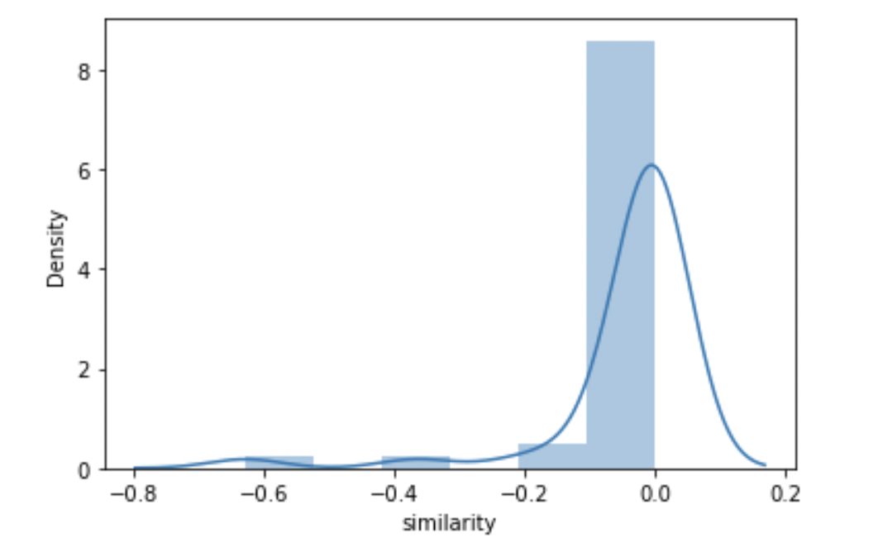
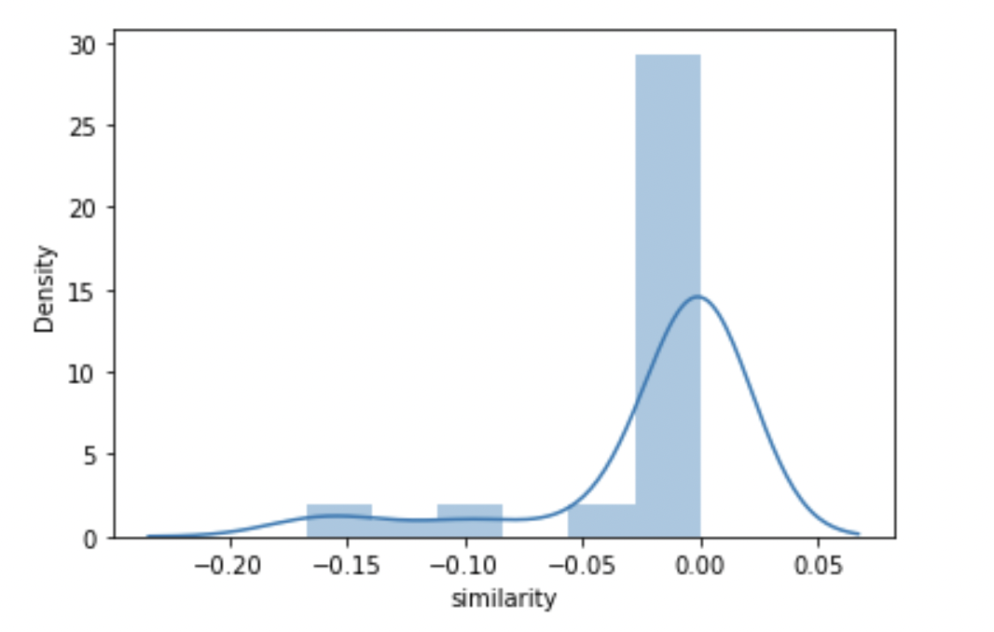
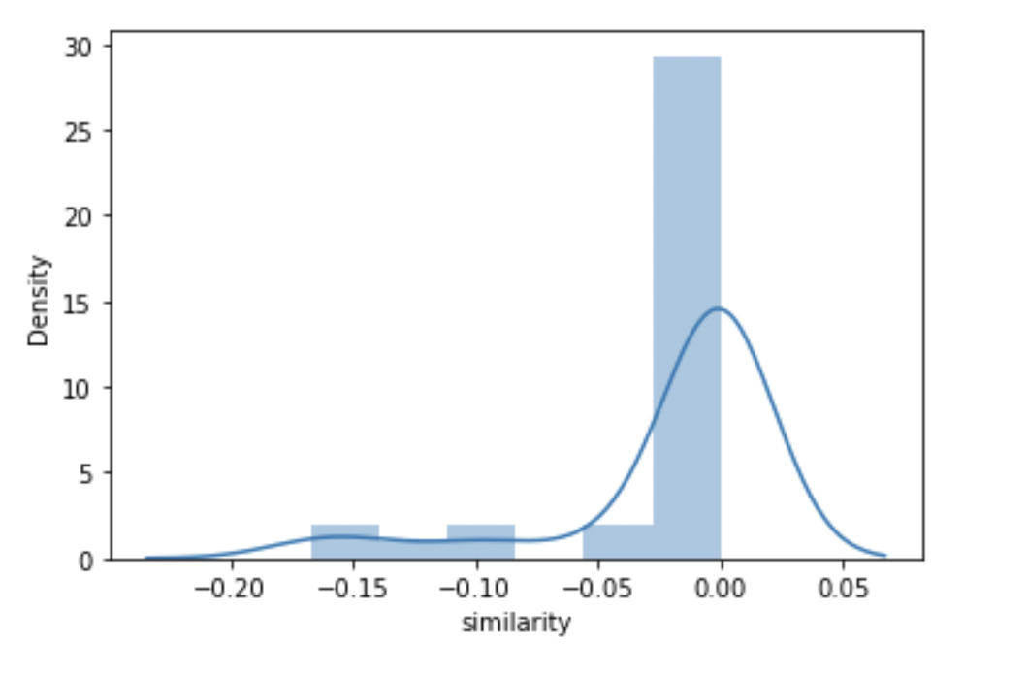
Phase 4-5 After Natural Log Transformation
Bogota 0 | Bogota 1
Bogota 2 | Bogota 3

Slide 22
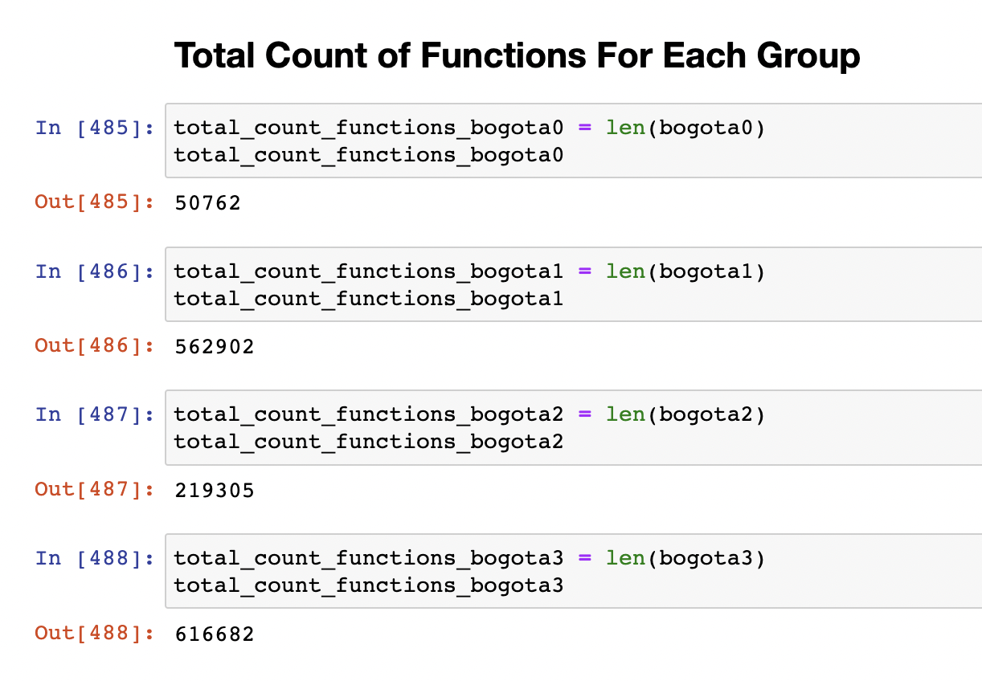
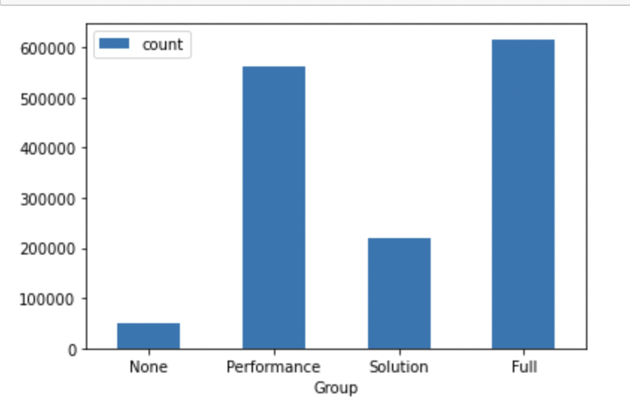
Total Count of Functions for Each Group

Slide 23


Total Unique Functions for Each Group

Slide 24

Median Count of Template Functions Per Individual

Slide 25

Median Template Similarity

Slide 26

Mean Count of Template Functions Per Individual

Slide 27

Mean Template Similarity

Slide 28


Distribution Plot of Template Functions Per Individual
Phase 1 | Phase 2

Slide 29


Distribution Plot of Template Functions Per Individual

Slide 30

Distribution Plot of Template Functions Per Individual

Slide 31

Median Functions Per Individual [ Variety ] [ Repetition Removed ]

Slide 32




Log Transformed Plot for Unique Functions
Bogota 3 | Bogota 2
Bogota 1 | Bogota 0

Slide 33

Median Rare Functions [ 10% Quantile ] [ Functions Level ]

Slide 34

Median Top 10% Rare Functions Per Individual [ Per Phase ]

Slide 35


Mean/Median Rare Functions [ 10% Quantile ] [ Individual Level ] [ Overall Case ]
Mean
Median

Slide 36


Mean/Median Rare Functions [ 20% Quantile ] [ Individual Level ] [ Overall Case ]

Slide 37

Distribution of Rare Functions [ 10% ] [ Individual Level ] [ Overall Case ]

Slide 38

Distribution of Rare Functions [ 20% ] [ Individual Level ] [ Overall Case ]

Slide 39

Phase 1 Error Bar for 10% Quantile

Slide 40

Phase 1 Boxplot for 10% Quantile
Extreme outliers
Potential Outliers

Slide 41

Phase 2 Error Bar for 10% Quantile

Slide 42

Phase 2 Boxplot for 10% Quantile
All outliers in this plot are ”extreme” outliers.

Slide 43

Phase 3 Error Bar for 10% Quantile

Slide 44

Phase 3 Boxplot for 10% Quantile
Extreme
Outliers
Potential Outliers

Slide 45

Phase 4 Boxplot for 10% Quantile

Slide 46

Phase 4 Error Bar for 10% Quantile
Extreme outliers
Potential outliers

Slide 47

Phase 5 Boxplot for 10% Quantile

Slide 48

Phase 5 Error Bar for 10% Quantile

Slide 49
Phase 1 Outliers [ Variety Unique Functions ] [ Repetition Removed ] [ Individual ]
Bogota 0 | Bogota 1 | Bogota 2 | Bogota 3
100 < X < 200 Count = 1 | 100 < X < 200 Count = 4 | 100 < X < 200 Count = 1 | 100 < X < 200 Count = 2
 | 200 < X < 300 Count = 1 | 500 < X < 600 Count = 1 | 30,000 < X < 40,000 Count = 1
 | 300 < X < 400 Count = 1 | 30,000 < X < 40,000 Count = 1 | 70,000 < X < 80,000 Count = 1

Slide 50
Phase 2 Outliers [ Variety Unique Functions ] [ Repetition Removed ] [ Individual ]
Bogota 0 | Bogota 1 | Bogota 2 | Bogota 3
100 < X < 200 Count = 1 | 100 < X < 200 Count = 6 | 100 < X < 200 Count = 3 | 100 < X < 200 Count = 2
7000 < X < 8000 Count = 1 | 200 < X < 300 Count = 1 | 400 < X < 500 Count = 1 | 300 < X < 400 Count = 1
 | 300 < X < 400 Count = 1 | 500 < X < 600 Count = 1 | 2,000 < X < 3,000 Count = 1
 | 1000 < X < 2000 Count = 1 | 2,000 < X < 3,000 Count = 2 | 30,000 < X < 40,000 Count = 1
 | 2000 < X < 3000 Count = 3 | 3,000 < X < 4,000 Count = 1 | 70,000 < X < 80,000 Count = 1
 | 20,000 < X < 30,000 Count = 1 | 30,000 < X < 40,000 Count = 1
 | 70,000 < X < 80,000 Count = 1

Slide 51
Phase 3 Outliers [ Variety Unique Functions ] [ Repetition Removed ] [ Individual ]
Bogota 0 | Bogota 1 | Bogota 2 | Bogota 3
100 < X < 200 Count = 1 | 100 < X < 200 Count = 6 | 100 < X < 200 Count = 4 | 100 < X < 200 Count = 4
2000 < X < 3000 Count = 1 | 200 < X < 300 Count = 2 | 400 < X < 500 Count = 1 | 200 < X < 300 Count = 1 300 < X < 400 Count = 1
7000 < X < 8000 Count = 1 | 300 < X < 400 Count = 1 700 < X 800 Count = 1 | 500 < X < 600 Count = 1 | 2,000 < X < 3,000 Count = 2
 | 1000 < X < 2000 Count = 1 | 2,000 < X < 3,000 Count = 3 | 30,000 < X < 40,000 Count = 1
 | 2000 < X < 3000 Count = 3 | 4,000 < X < 5,000 Count = 1 | 70,000 < X < 80,000 Count = 1
 | 20,000 < X < 30,000 Count = 1 | 30,000 < X < 40,000 Count = 1
 | 80,000 < X < 90,000 Count = 1

Slide 52
Phase 4 Outliers [ Variety Unique Functions ] [ Repetition Removed ] [ Individual ]
Bogota 0 | Bogota 1 | Bogota 2 | Bogota 3
100 < X < 200 Count = 1 | 100 < X < 200 Count = 6 | 100 < X < 200 Count = 3 | 100 < X < 200 Count = 2
7000 < X < 8000 Count = 1 | 200 < X < 300 Count = 1 | 400 < X < 500 Count = 1 | 300 < X < 400 Count = 1
 | 300 < X < 400 Count = 1 | 500 < X < 600 Count = 1 | 2,000 < X < 3,000 Count = 1
 | 1000 < X < 2000 Count = 1 | 2,000 < X < 3,000 Count = 2 | 30,000 < X < 40,000 Count = 1
 | 2000 < X < 3000 Count = 3 | 3,000 < X < 4,000 Count = 1 | 70,000 < X < 80,000 Count = 1
 | 20,000 < X < 30,000 Count = 1 | 30,000 < X < 40,000 Count = 1
 | 70,000 < X < 80,000 Count = 1

Slide 53
Phase 5 Outliers [ Variety Unique Functions ] [ Repetition Removed ] [ Individual ]
Bogota 0 | Bogota 1 | Bogota 2 | Bogota 3
100 < X < 200 Count = 1 | 100 < X < 200 Count = 6 | 100 < X < 200 Count = 3 | 100 < X < 200 Count = 2
7000 < X < 8000 Count = 1 | 200 < X < 300 Count = 1 | 400 < X < 500 Count = 1 | 300 < X < 400 Count = 1
 | 300 < X < 400 Count = 1 | 500 < X < 600 Count = 1 | 2,000 < X < 3,000 Count = 1
 | 1000 < X < 2000 Count = 1 | 2,000 < X < 3,000 Count = 2 | 30,000 < X < 40,000 Count = 1
 | 2000 < X < 3000 Count = 3 | 3,000 < X < 4,000 Count = 1 | 70,000 < X < 80,000 Count = 1
 | 20,000 < X < 30,000 Count = 1 | 30,000 < X < 40,000 Count = 1
 | 70,000 < X < 80,000 Count = 1

Slide 54

Count of Least Common Functions ( Top 5% )

Slide 55

Count of Least Common Functions ( Top 10% )

Slide 56

Count of Unique Functions ( Top 15% )

Slide 57

Count of Unique Functions ( Top 20% )

Slide 58

Mean of Exploration for Each Individual

Slide 59

Median of Exploration for Each Individual

Slide 60

Distribution Plot for Exploration Metric [ Full Transparency ]

Slide 61

Distribution Plot for Exploration Metric [ Solution Transparency ]

Slide 62

Distribution Plot for Exploration Metric [ Performance Transparency ]

Slide 63

Distribution Plot for Exploration Metric [ No Transparency ]

Slide 64

Mean of the highest similarity score to the other person

Slide 65

Median of the highest similarity score to the other person

Slide 66

Mean Highest Similarity in Global Functions Context

Slide 67

Median Highest Similarity in Global Functions Context

Slide 68

Minimum Highest Similarity in Global Functions Context

Slide 69

Overlap of No Transparency Case with All Others

Slide 70

Overlap of No Transparency Case with All Others

Slide 71

Overlap of No Transparency Case with All Others

